Slide 1

Fake News Detection

Slide 2

Information Disorder Misleading Damaging Reputation Fabricated Claims

Slide 3

Problem Statement

Slide 4

Defining the Problem
In this era of social media and alternative news sources, it has become a huge difficulty to identify fake news from true news.
From democracy to the global economy everything is affected largely by false information. In that context, it is important to identify fake news as soon as it is available to limit its influence on people.

Slide 5
Data
kaggle

Slide 6
Two (2) CSV files
The data was collected from Kaggle.
The dataset consists of two (2) csv files each containing news that were already labelled as true and fake.

Slide 7
Data cleaning
WRAngling

Slide 8

Process for cleaning the data
Descriptive statistics was used to check for missing values
Data cleaning was performed to remove tags, white spaces, numbers and contractions.
Utilized NLTK library lemmatization to convert all words to its root. This helped to identify similar words.
Stopwords, (the, a, of, etc.) were removed.

Slide 9
Exploratory data analysis
Data investigation

Slide 10
EDA
Data was mapped as TRUE into 1 and FALSE into 0 to verify if the dataset was balanced.
Bar charted was plotted of the number of articles per subject.

Slide 11
Wordcloud Fake news
World clouds were created to see the words that were most common in each of the categories.
Trump, said, people, president, and would seems to be the most prominent words in Fake News.

Slide 12
Wordcloud True news
World clouds were created to see the words that were most common in each of the categories.
Looking at the wordcloud of true news, the most prominent words were said, Trump, us, would, and Reuters.

Slide 13
Modeling
Data visualization

Slide 14
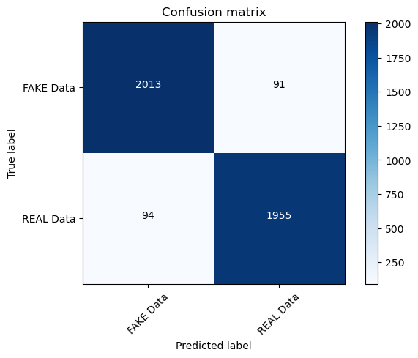
Visualize Data
The models used in this learning were the Passive Aggressive Classifier, Decision Tree Classifier, and Random Forest Classifier.
The accuracy scores were reported as follows: Passive Aggressive Classifier (95.55%), Decision Tree Classifier (88.15%), and Random Forest Classifier (90.73%).
The top model was the Passive Aggressive Classifier based on the data and the confusion matrix.

Slide 15

Conclusion
In this project, the objective was to predict fake and true news using NLP and machine learning methods.
There was success in developing a Passive Aggressive Classifier model that can predict TRUE and FAKE news with an accuracy score of 95.55%.

Slide 16

THANK YOU
Angela K. Dunston

